Slide 1
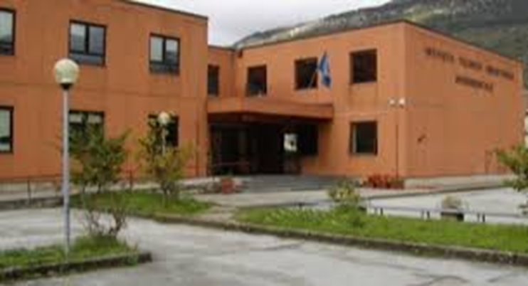
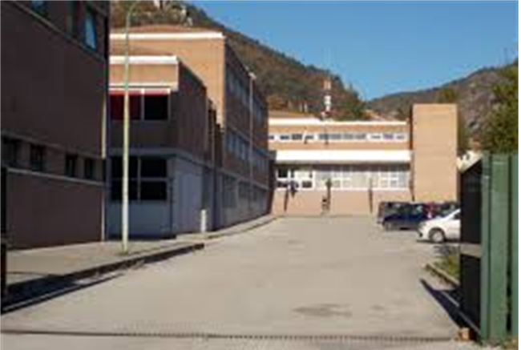
DEALING WITH STEREOTYPES IN OUR SCHOOL

Slide 2
TOTAL NUMBER OF PUPILS ATTENDING THE SCHOOL
951 (108 foreign pupils, 11,36%)
They live in Gubbio and in many others towns, both around Gubbio and other parts of Umbria, and in neighbouring regions

Slide 3
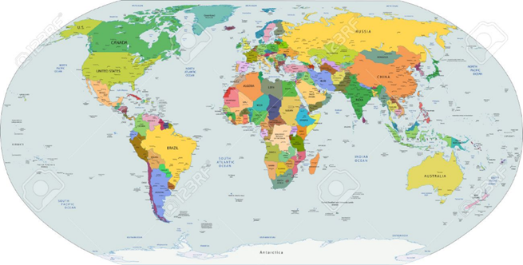
MOST OF THE FOREIGN PUPILS COME FROM
Albania
Morocco
Romania
Republic of Macedonia
Ecuador
Tunisia
Kosovo

Slide 4
TEACHING/LEARNING STRATEGIES to get over stereotypes
Inclusion activities for pupils with special education needs
Italian language courses for different learning needs:
*first approach in literacy *reinforcement
*in-depht analysis

Slide 5
TEACHING/LEARNING STRATEGIES to get over stereotypes
Daily management of School CIC (Counselling Information Centre)
- to promote the personal/social development of students in a safe, inclusive learning environment
- to provide individual and/or small group counselling, classroom guidance, prevention education and student–centred interventions
- to facilitate the students’ development in different areas: academic development, personal and social development, carreer development

Slide 6
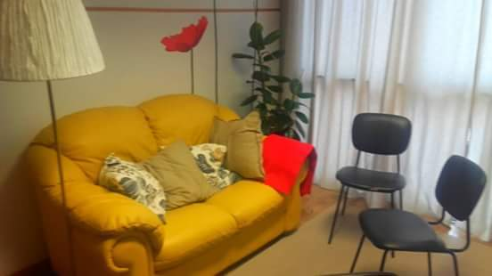
TEACHING/LEARNING STRATEGIES to get over stereotypes
Daily management of School CIC (Counselling Information Centre)

Slide 7
TEACHING/LEARNING STRATEGIES to get over stereotypes
In this place students can speak about the problems, difficulties and conflicts they have in their class or in their personal life. Students can be supported by specialized people, like psychologists and counselors.
They have the possibility to confide their troubles and their discomfort and can share any kind of emotion, such as sadness, anger, fear, but also happiness and satisfaction.
Through these types of activities students can improve their quality of life and fulfill their school targets.

Slide 8
TEACHING/LEARNING STRATEGIES to get over stereotypes
Project: «The foreigner in our imagination: The Island by Armin Greder»
Reading to primary school students
meeting a refugee
Videobook
Project: «Course Yaps: Young and Peer Education»
having a workshop on sexuality and affectivity

Slide 9
TEACHING/LEARNING STRATEGIES to get over stereotypes
Project: «Don’t tell me you are afraid by Giuseppe Catozzella»
Reading tournament
meeting with the author, in collaboration with the municipal Library
Project: «When we were them: a short story of Italian emigration»
Using real photos, original newspapers and letters

Slide 10
TEACHING/LEARNING STRATEGIES to get over stereotypes
Participation in initiatives organized and managed by the municipal Library in collaboration with schools, associations and public bodies:

Slide 11
TEACHING/LEARNING STRATEGIES to get over stereotypes
Memory Day to remember the Shoa and to promote a culture based on peace, tolerance and dialogue against every form of racial, ethic and religious hatred (meetings with survivors from concentration camps, writers and historians; films; discussions)

Slide 12
TEACHING/LEARNING STRATEGIES to get over stereotypes
Reading the contemporary to understand and dealing with the phenomenon of migration and to prevent every form of prejudice, intolerance and discrimination (meetings with asylum-seekers, refugees, writers; films; discussions; workshops, reading itineraries)

Slide 13
TEACHING/LEARNING STRATEGIES to get over stereotypes
International Day against violence on women to promote more awareness about this social and cultural problem (meetings with experts and writers; films; discussions; workshops; reading experiences)

